Slide 1

Act Locally, Impact Globally

Slide 2
Lecture 7: Data Wrangling II
Handling Outliers

Slide 3
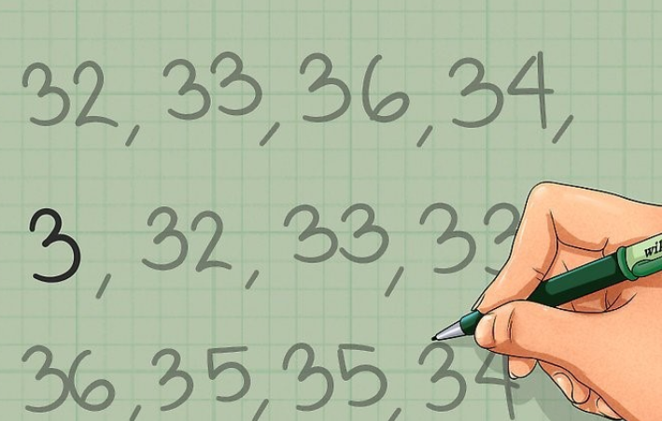
Outliers
Notes:
What do you think about these numbers ?
What these numbers may be representing ?
What about 3 ?
How you figure out that 3 is an outlier?
What is the range of tis data?
What is the range If I exclude 3?

Slide 4
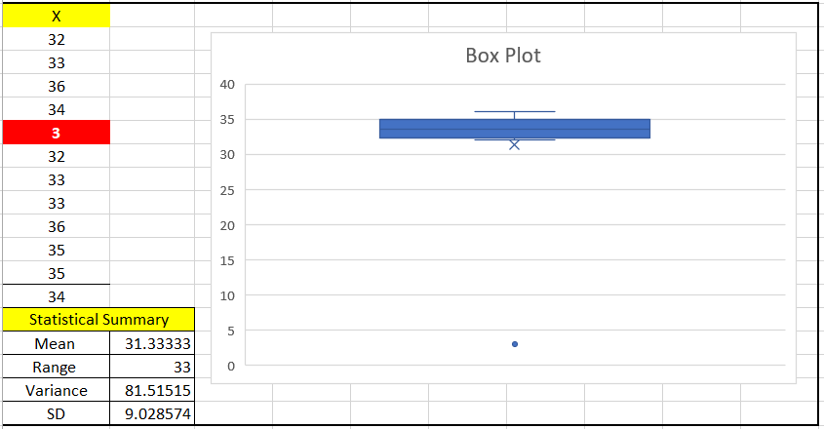
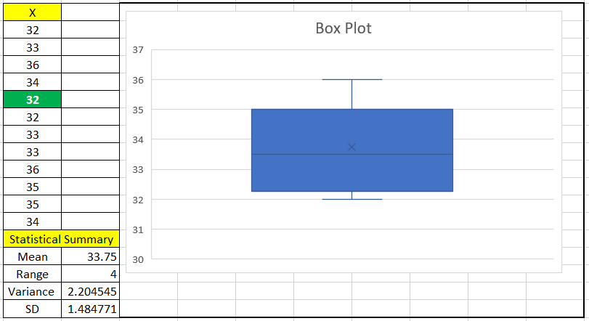

Slide 5
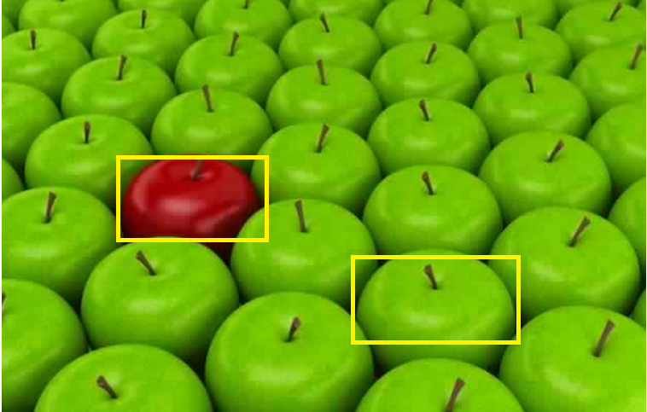
Outliers
Notes:
What is odd in this image with respect to outliers?
How a machine will distinguish between colors?
How an image is stored in memory?
How a machine will detect a red apple as an outlier?

Slide 6
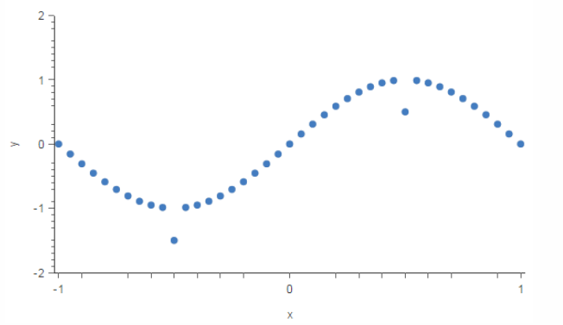

Outliers
Notes:
What is odd in this line plot ?
These two blue points look different from rest of the points because they are not following the pattern which is followed by rest of the points.

Slide 7
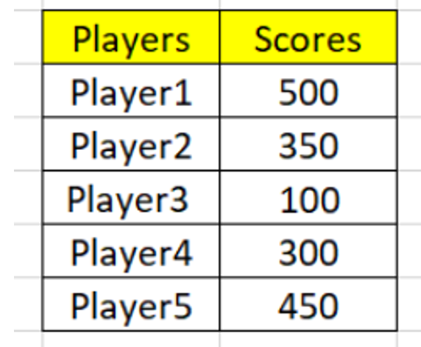
Outlier Example
Consider the Total Scores of 5 batsmen in last 10 T20 Internationals.

Slide 8
Outlier Example
As you can see from the collected data that all other players scored 300+ except Player3 who scored 100.
This figure can be just a typing mistake or it is showing the variance in your data and indicating that Player3 is performing very bad so, needs improvement.
Consider the Scores of 5 batsmen in last 10 T20 Internationals.

Slide 9
Outliers
Definition :
Data Points which do not follow a particular data distribution ( Followed by the majority of other data points) are called outliers
An outlier is a data point that is distant from other majority points.
They may be due to variability in the measurement
They may be a result of experimental errors.
If possible, outliers should be excluded / handled from the data set before training a machine learning model.

Slide 10
Effect of Outliers on ML Algorithms
Machine learning algorithms are very sensitive to the range and distribution of attribute values.
Data outliers can spoil and mislead the training process resulting in:
Longer training times,
Less accurate models, and
Ultimately poo results

Slide 11
Sometimes Outliers can be important
To Detect Suspicious Activates / Anomaly Detection
Suspicious Activity / Anomalies
A deviation in Financial Transactions Pattern
A deviation in network traffic
Suspicious Browsing Patterns
Detecting Spam Emails
Detecting unusual Email Communication with in or outside the organization

Slide 12
Outlier Detection Techniques
Discover Outliers with visualization tools
Using Univariate Analysis
Using Bivariate Analysis
Using Mathematical Functions
Z-Score
IQR / Tukey Method

Slide 13
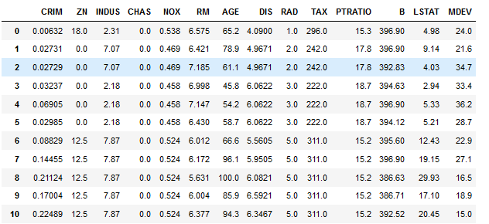
An Example Dataset – Boston Houses

Slide 14
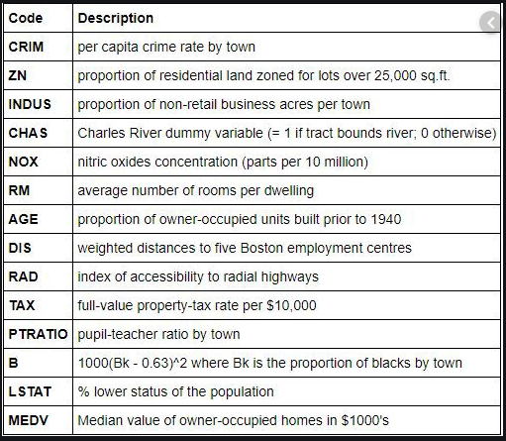
Dataset Description

Slide 15
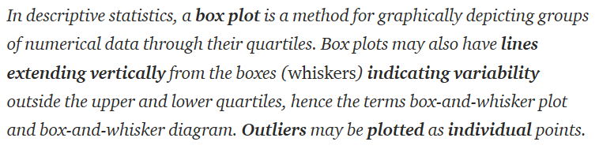
Discover Outliers using Visualization Tools
Univariate Analysis using Boxplot

Slide 16

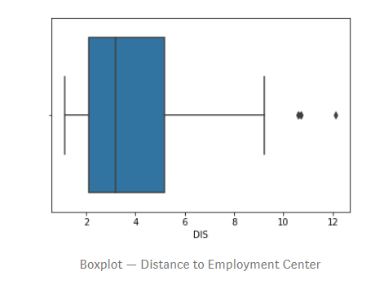
Boxplot

Slide 17
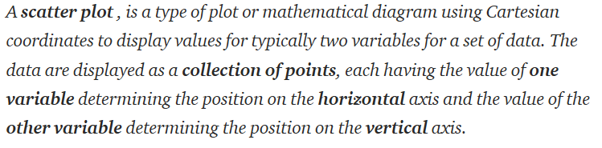
Scatter plot Bivariate Analysis

Slide 18
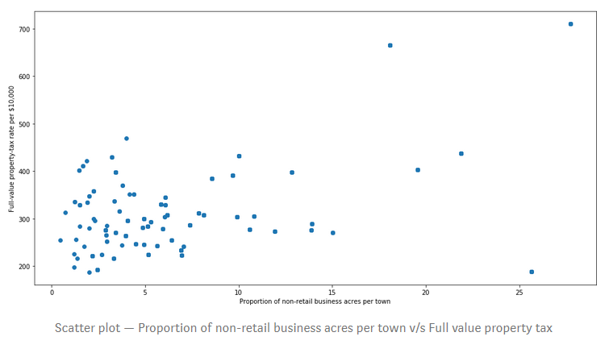
Scatter plots – Bivariate Analysis

Slide 19
Outlier Detection using Mathematical Functions
Z-Score
IQR ( Inter Quartile Range)

Slide 20
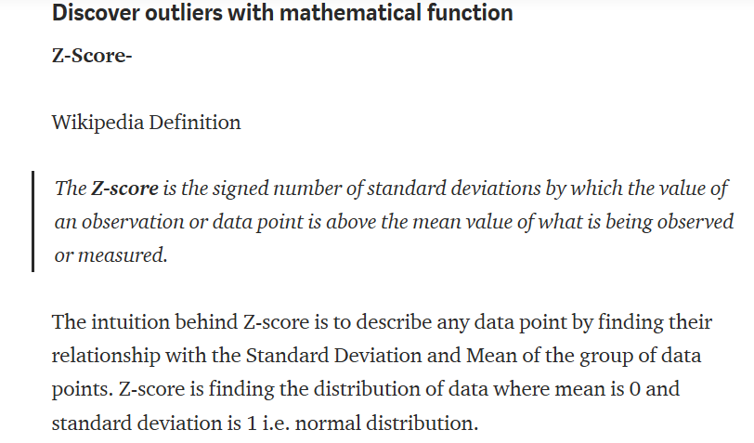
Z-Score

Slide 21
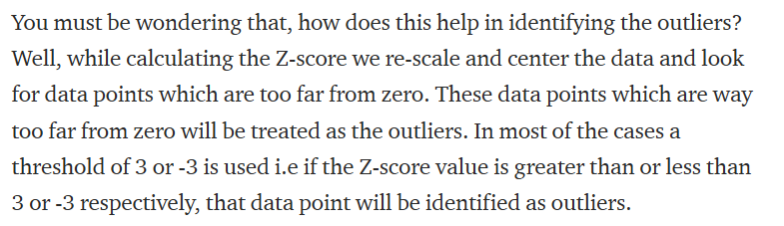
Z-Score

Slide 22
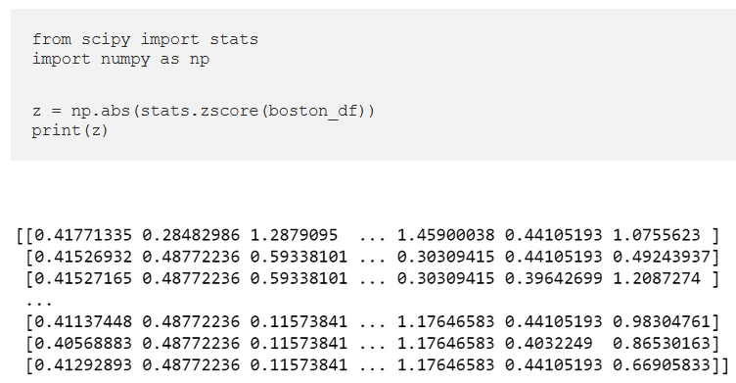
Z-Score

Slide 23
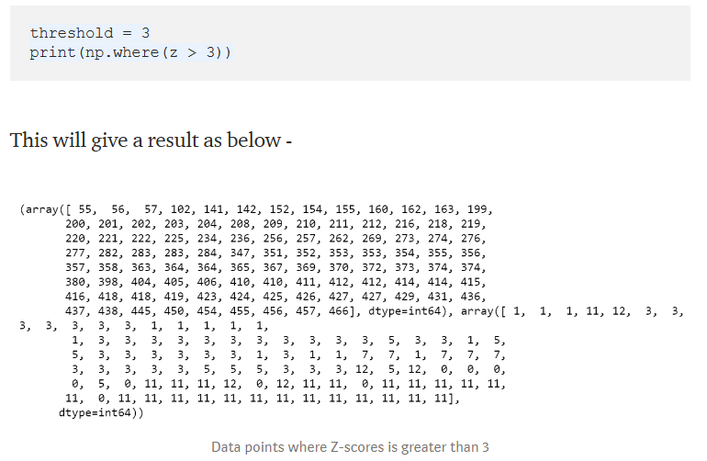
Z-Score

Slide 24
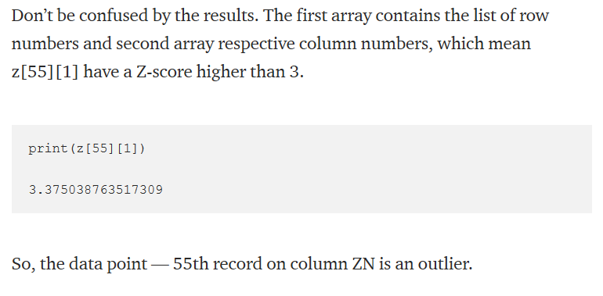
Z-Score

Slide 25
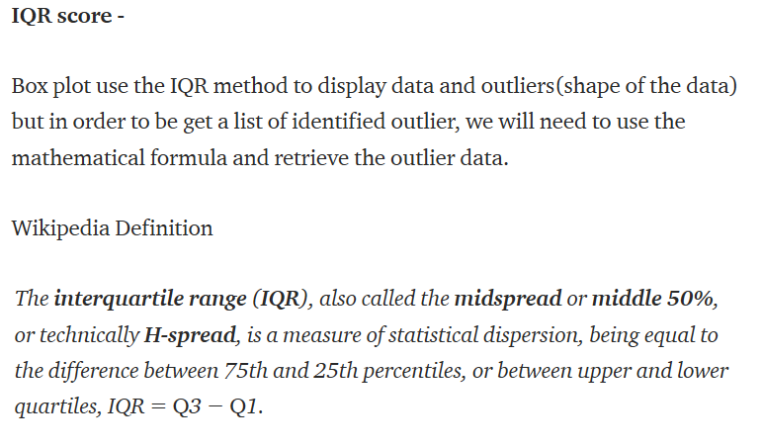
IQR Score

Slide 26
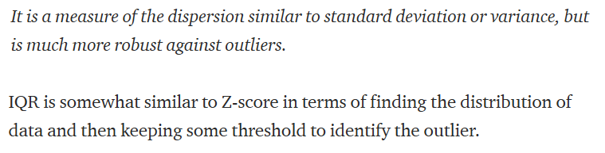
IQR

Slide 27
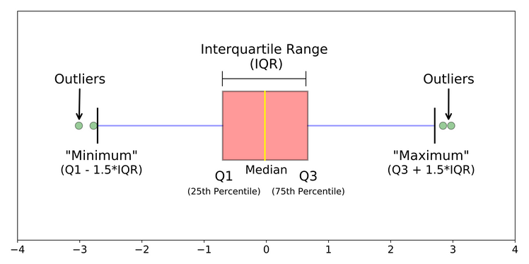
IQR – Box Plot

Slide 28
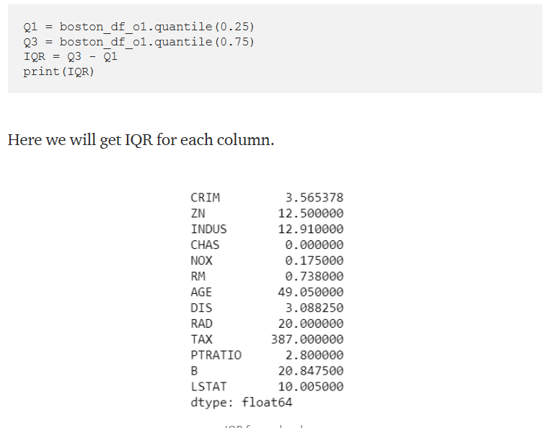
Finding IQR

Slide 29
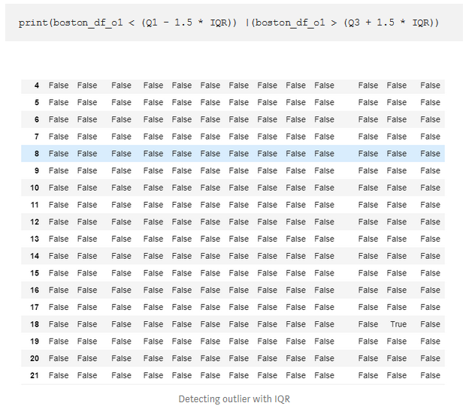
IQR

Slide 30
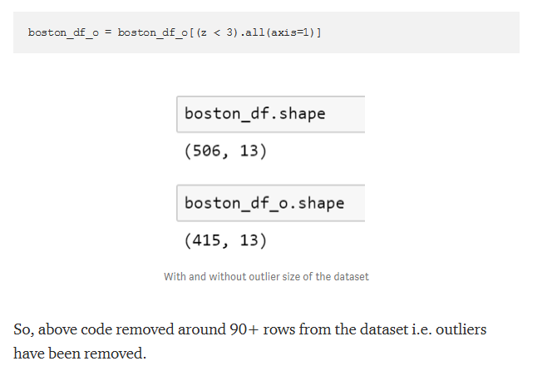
Removing Outliers

Slide 31
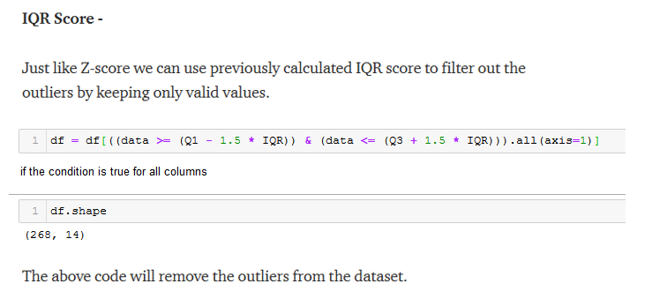
Removing Outliers

Slide 32
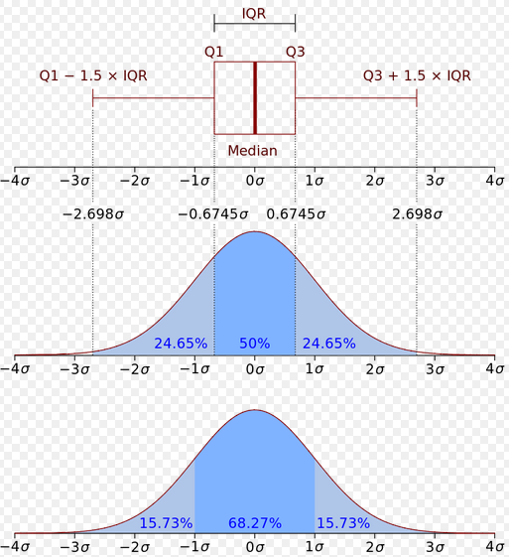
IQR vs Z-Score

Slide 33
Summary
Outlier are data points which vary from all other data point by a defined threshold
Outliers tend to impact the model performance badly
Sometimes we are interested in normal behaviour , so should remove outliers
Sometimes outliers may be our focus.
There are various methods for outlier detection and removal
Z-Score and IQR are the most effectively and widely used
There are methods based on clustering as well

Slide 34
Hands On :
Detecting & Removing Outliers

Slide 35
Boston House Dataset
To Do :
Load Boston House Dataset from sklearn datasets
Convert the dataset into a Pandas Dataframe
Plot Boxplot for ‘DIS’ attributes and see the outliers
( You can check other attributes as well)
Plot Scatter Plot for ‘INDUS’ and ‘TAX’ attribute to check outliers
( You can plot other combinations as well)
Using Z-Score , find out the outliers ( Use 3 as threshold)
Using IQR , find out the outliers
Remove outliers based Z-Score
Remove Outliers using IQR Score

